Slide 1
Zillow real estate price analysis
Module 4 project
N. Kairakbayev
Notes:
Hi!. Let me present you an Executive Summary of US real estate prices research

Slide 2
Zillow Real Estate Price Dataset
# of price indices
Hierarchy
~ 14 723 Region monthly price values
from 1996-04 to 2018-04
7 554 cities
1 212 Counties
702 Metropolitans
51 State
1996-04
in total 265 months
2018-04
Notes:
I’ve used dataset provided by Zillow. It contains price time series per for 14 723 regions. The prices are monthly based and cover a period from April 1996 to April 2018, 265 months in total. The dataset also contains details on geographical location for given regions which are cities, counties, closest Metropolitans and States.

Slide 3

Key Questions
What are the top 5 best zipcodes for us to invest in?
Key aspects
Profit metrics
Risk metrics
Profit and Risk trade-off
Forecast period
Notes:
Key question for us is to define TOP5 best regions for investing. Before seeking the ways and answer to that, we need to understand what kind of metrics we can use for measure investments’ performance. And, since we will use forecasted estimations, we also have to remember about risk measure which leads us to finding trade-off between profit and risk. Depending of model’s ability to create robust forecast, we will define recommended forecast period.

Slide 4
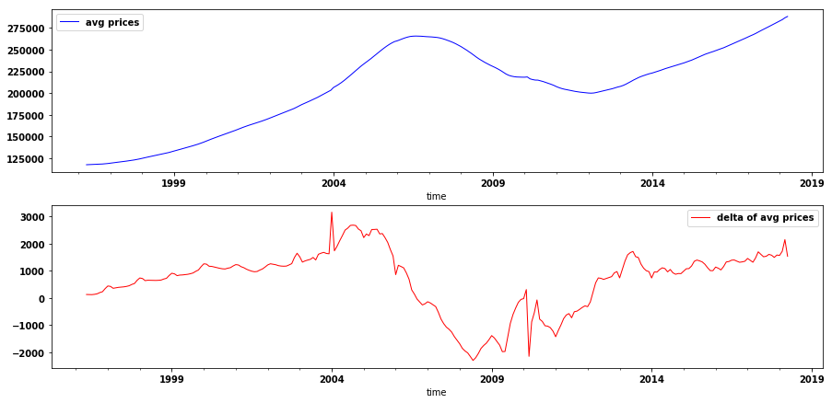
Average prices
Global cycles (15+ years)
No significant intra-year fluctuations
Some intra-year seasonality on price changes
Notes:
Now, let’s see initial prices dynamics. Here you can observe prices and delta prices (monthly changes) based on averaged prices. Firstly, we can notice some global cycles (seasonality) for prices (which could take 15 years periods). I suppose, that it linked to global economic cycles. Secondly, prices are relatively smooth within a year. If we looks to delta prices, we can notice some seasonality within a year. In overall, it is clear, that there is a positive trend for prices, which is expected for such long-term period.

Slide 5
Forecast Methodology and Metrics
Investment Profitability Indicator: forecasted IRR
Investment Risk Indicator: IRRmax – IRRmin,
statistically significant amplitude of forecast
Models fit on Regions and Ranking
Per Region, per County and per State
Model Parameters
SARIMA models per selected groups
Filtering by Benchmark AIC
IRR and IRR-spread calculation
Profit and Risk trade-off ranking
TOP5 Region, Counties and States
on averaged prices
EDA
SARIMA model
Benchmark AIC
Forecast horizon
on averaged prices
Data Preparation
Stationarity Tests
Autocorrelation
Month vs Year
Pandas
Notes:
A few words about methodology used in the work. I’ve chosen IRR as estimation of Profitability, which is widely used as KPI for investments for period with length more than 1. Our price forecasts will contain low and high estimations based on statistically significant intervals, and difference between high and low level of IRR is reflect to expected fluctuations of IRR and could be treated as risk measure. In general, I used 4 main steps in the work. After data preparation (technical step), I tested dataset on stationarity and autocorellation in order to understand model specification for next steps. One of important issue here – is to resizing time series from monthly based index to annual based index which not harm outputs, but significantly reduce time for calculation. The third step consists of 1 model runs based on averaged prices. The main outcome here is SARIMA model parameters for next step. In the last step I’ve run a set of models for each region with fixed params from previous step, calculate IRR and IRR spread and define top5 regions with trade-off mechanism. Additionally, I’ve calculated same outcomes for Counties and States. More details of methodology is on the APPENDIX A slide.

Slide 6

Profit vs Risk Trade-off
Highest Rate of Return
Lowest Risk
TOP5
INTERSECTION of 2 SORTED LISTS
Notes:
Let me give a brief explanation of trade-off mechanism. Truly speaking, it is quite simple rule: so, we create 2 sorted lists of regions. The first list sorted by IRR in ascending order, the second – by Risk in descending order. Intersection of those lists with same 5 regions – is the answer of TOP5 regions. This is what can be called – balanced choices.

Slide 7
TOP 5 Best Regions
ZIPCODES for 1-year horizon
14414 (Avon, NY)
14423 (Caledonia, NY)
14485 (Lima, NY)
19023 (Darby, PA)
44102 (Cleveland, OH)
Lowest IRR
IRR median
Highest IRR
ZIPCODES for 3 and 5-year horizons
17701 (Williamsport, PA)
17702 (South Williamsport, PA)
19023 (Darby, PA)
44102 (Cleveland, OH)
65255 (Hallsville, MO)
1-year investments
3-year investments
5-year investments
5.3% ± 2,0%
2,3% ± 1,1%
2,15% ± 0,6%
Notes:
Here you can see results of modelling and ranking. So, we have 2 sets of best balanced regions: for 1-year investments and 3-5 year investments. On the right side of presentation, IRR estimations are presented, where Lowest IRR and Highest IRR were taken from forecast bounds. For 1-year payback investments in average 5,3% IRR could be obtained from top5 regions. Average amplitude is 2% (half of spread). Some important issue here: profit measure is decreased with increasing forecast length, which happens because decreasing forecast power with increased length.

Slide 8
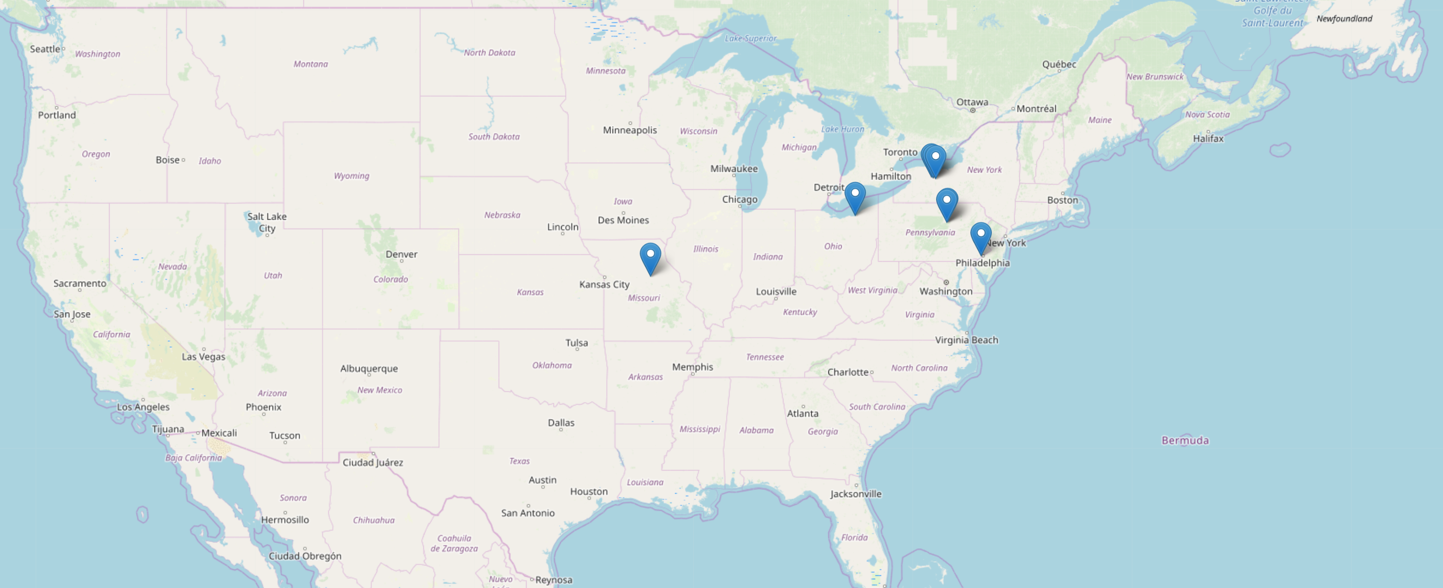
TOP 5 Best Regions: map
TOP ZIPCODES: 44102, 17701, 17702, 19023, 65255, 14414, 14423, 14485
Notes:
Here you can see locations of TOP5 best zipcodes in the MAP. The overall number of regions is higher than 5 because I put here TOP5 for 1-year and TOP5 for 3-year periods.

Slide 9
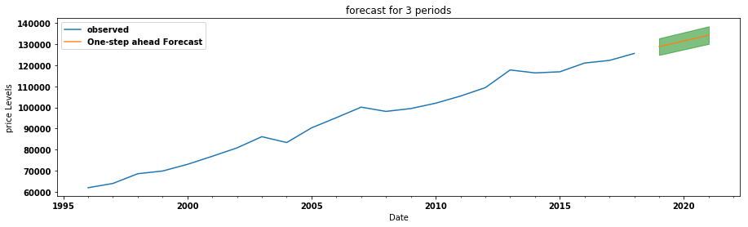
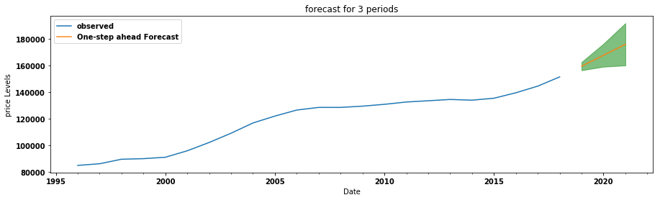
3-year Forecast Charts
<= 17701 (Williamsport, PA)
14414 (Avon, NY) =>
Notes:
Here, I’ve put 2 examples (region 17701 and 14414) of how forecasts looks like. You can see, that shape of confidence intervals could be different for different regions and it depends on individual data for a region.

Slide 10
TOP5 Best Counties and States
COUNTIES |  | STATES
1-year | 3-year | 1-year | 3-year
Allegheny | Chemung | Iowa | Iowa
Erie | Erie | Nebraska | Nebraska
Maury | Maury | Ohio | Ohio
Pontonoc | Pontonoc | Oklahoma | Alaska
West Baton Rouge | Dubuque | South Dakota | South Dakota
4.4% ± 2.4% | 4.1% ± 2.3%t | 4.0% ± 2.3% | 3.8% ± 3.3%
Notes:
In this table you can figure out TOP5 sets for Counties and States. The main idea is that increasing location scale leads to decrease estimated IRR, which is logically correct, because upscaling datasets decrease mean values of prices and IRR.

Slide 11
TOP5 Best States
TOP 5 STATES:
Alaska
Oklahoma
Ohio
Iowa
South Dakota
Nebraska
In total 6 states as union of 1-year and 3-year lists
Notes:
In this slide you can see the location of best states in the US map.

Slide 12
Business Recommendations
Prices on the given dataset could be forecasted with high and moderate level of accuracy
Recommended forecast length: 5 years or less
Top5 zipcodes for investments:
for 1-year maturity: 14414, 14423, 14485, 19023, 44102;
for 3-5-year maturity: 17701, 17702, 19023, 44102, 65255
Median IRR for TOP5 zipcodes: 5,3% (1-year), 2,3% (3-year), 2,1% (5-year)
Top5 counties for investments (3-year): Erie, Keweenaw, Maury, Pontonoc, Dubuque
Top5 states for investments (3-year): Alaska, Iowa, Nebraska, Ohio, South Dakota
Notes:
So, let me state main findings and recommendations. The provided dataset is gives us the opportunity to create predict models for prices. I can say, that obtained results have high and moderate level of prediction quality and forecasts should be limited by 5 years length. Based on IRR metrics we can define top5 regions as it shown in the conclusion slide with IRR varied from 5,3% to 2,1%. Additionally, you can figure out top5 counties and top5 states for investing.

Slide 13
Future Work
Add advanced financial KPI for profit and risk measurements and verify ranking results
Add macroeconomic data (GDP growth, rise of population, etc) as additional predictors to Prices
Increase forecast power by finding ways of optimizing calculations complexity for monthly based index
Notes:
Of course, the given executive summary shows a snapshot of current discovery works. And there are many ways to expand and impove forecast quality. In this slide I’ve 3 general point to get that. The first is about KPI. Applied indicator is the thing highly depends on business aspects. For example, if we concentrate on 1-year investments, there are many other indicators for profitability measure. The second point is about adding some local (per State) or global (per Country) macroeconomic data to the dataset as possible price predictors. Remember 15-years cycles in price chart. So, such data could be the answer for that. And the third point. In current state, running the code, but on monthly based data – is extremely rise calculation time. On the other hand, forecast accuracy could be increased. So the task here – is to find optimal way with low cost.
Thank you for attention!

Slide 14
Appendix

Slide 15
Appendix A. Detailed Calculation Steps
E. Advanced tests
Calculate and compare with forecast charts from E a set of models with different optimal SARIMA params for each row
Run and compare Monthly Based model and forecast with results from prev.steps (annualy based)
D. Models Fit
B. Benchmark SARIMA
Run all TS with 3 DF with fixed SARIMA params (from B)
Filter results with Benchmar AIC (see in B) and collect to DF
Calculate IRR and IRR-spread for each filtered row and add to DF
Prepare TS with avg-prices
Find optimal SARIMA-params (0,1,1)(0,1,1,1)
Calculate benchmark AIC (376)
A. EDA
C. Prepare data for model
E. Ranking
Check stationarity (ADF test)
Check ACF and PACF
Check monthly ts vs rolling ts with 12month
Choose resize option (YEAR) and range for SARIMA params (0,1) – as pqd and s=1
1. For original question: row ~ Region
2. Additional 1: row ~ County, prices – averaged
3. Additional 2: row ~ State, prices – averaged
4. Time period for (1)-(3) - Year
Rank all rows (Regions, Counties and States) in 3 DF by IRR and IRR_spread
Collect top best (5) results and put to resulting DF

Slide 16
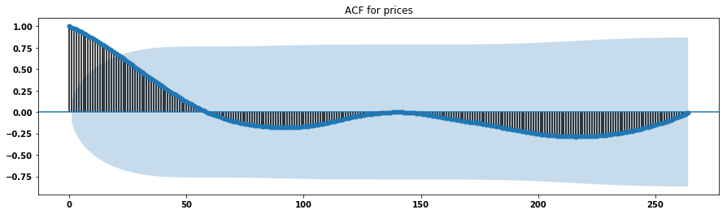
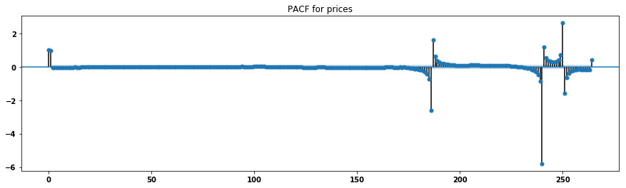
Appendix B. ACF and PACF
The charts above calculated on average prices

Slide 17
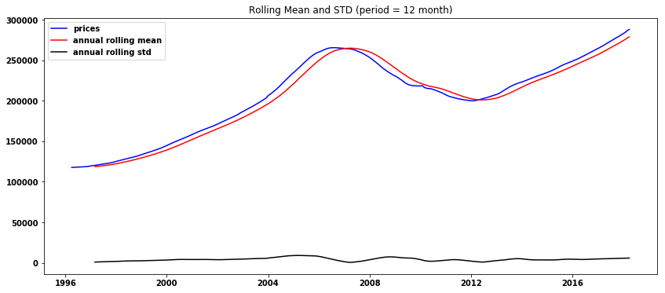
Appendix C. Month vs Year
The charts above calculated on average prices

Slide 18
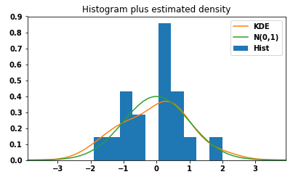
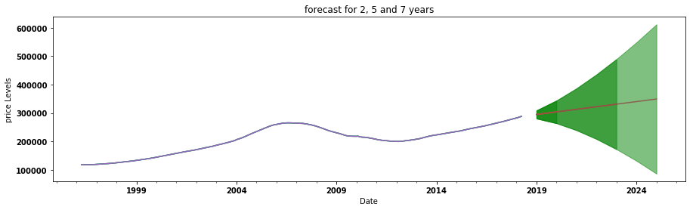
Appendix D. Benchmark model and forecast
Residual params and Validation:
P-values: less than 1%
Skew: -0.03
Kurtosis: 2.56
Best Model Params:
Data: average price p.a.
pdq: (0,1,1)
PDQs: (0,1,1,1)
AIC: 376
The chart above calculated on average prices

